Slide 1
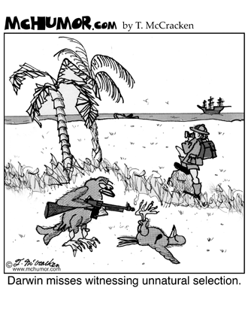
Aim: How did different species appear? Natural Selection
http://www.youtube.com/watch?v=NHNDPdlqGQ8
DO NOW: What is this cartoon telling us?

Slide 2
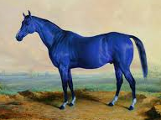
What is the definition of Evolution?
Evolution is the change in the traits of a
population of organisms over time.
Evolution is not the change of a single individual.
Example: If a horse is born blue and it is the only horse in the herd that is blue; no evolution has occurred.
If a blue horse has an advantage to survive and reproduce where the gene is passed on to its offspring; and over time more blue horses are born- that is evolution.

Slide 4
Factors that Force Evolution
For evolution to occur certain factors are needed:
Mutations – new traits are created when the gene for a trait has changed at the DNA level (mutation).
Could be change in color, body design, specialized body parts.
The Environment –
An increase in radiation, food types or temperature can lead to an increase in mutations.
Change in climate can change which individuals have an advantage in a population.
Isolation – organisms that are isolated tend to mate which genetically similar individuals, causing few changes in the population.
Open spaces – organisms that have wide ranges of mates will tend to have populations that are more diverse.

Slide 5
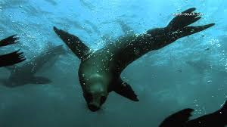
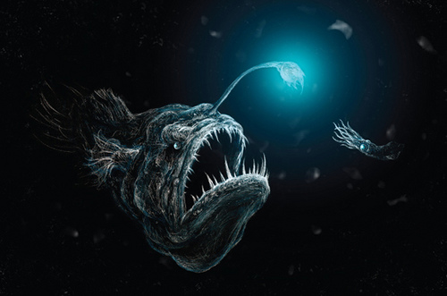
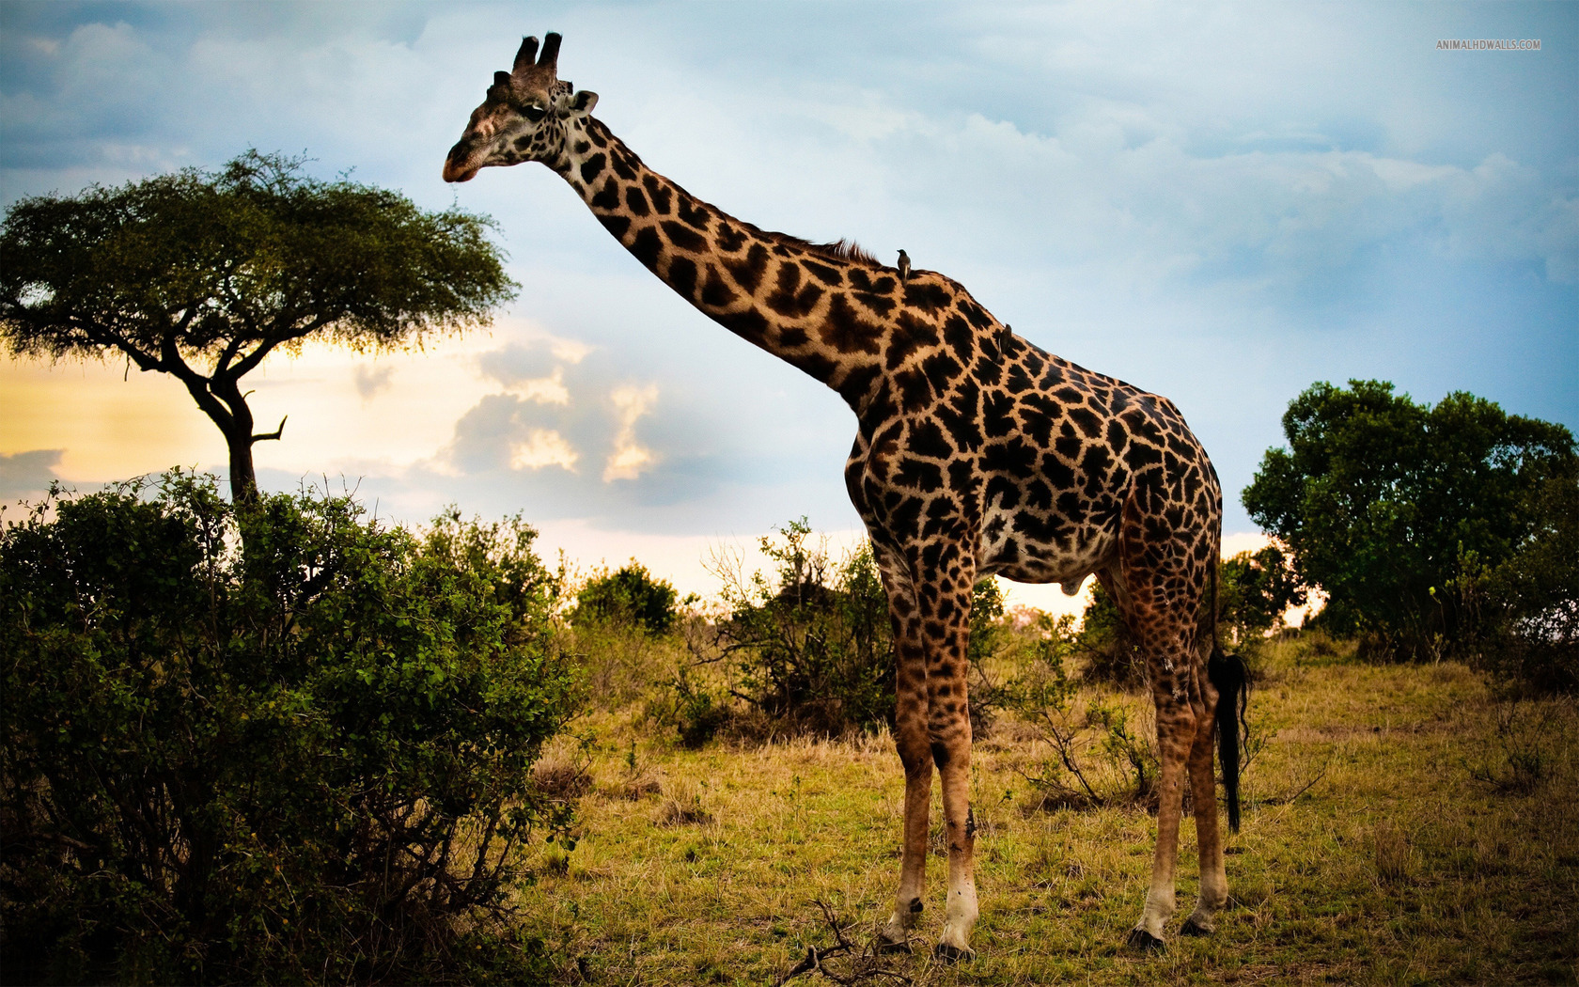
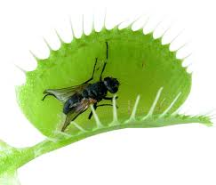
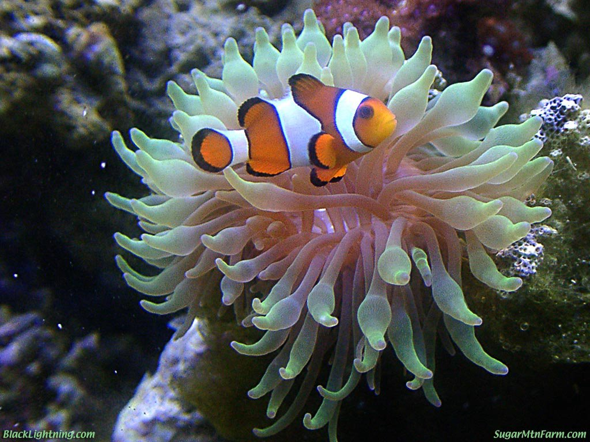
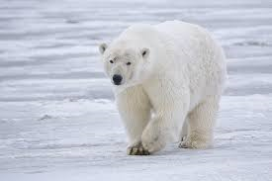
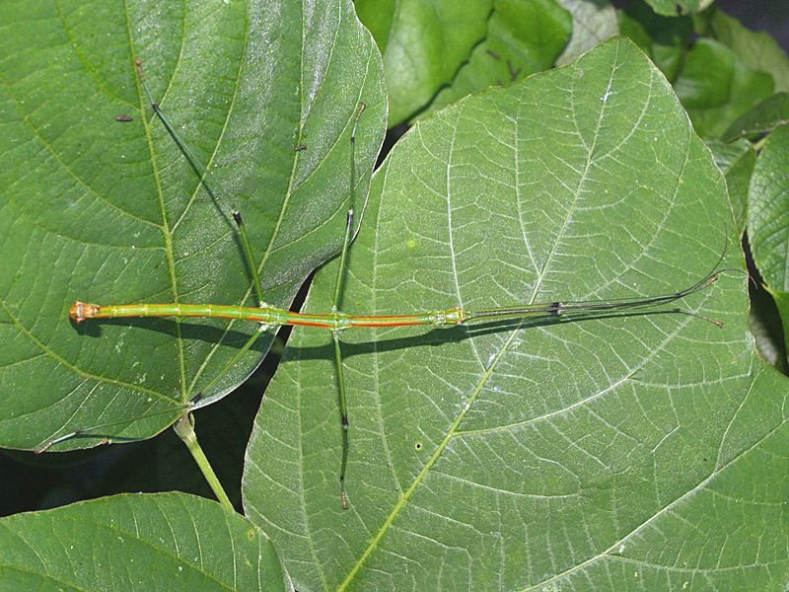

Slide 6
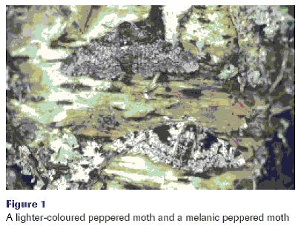
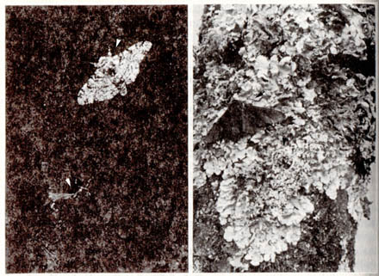
What is survival of the fittest? What is natural selection?
Natural selection is the idea that nature (predators, climate change, environmental changes) will “select” which organisms will live (the fittest) and which organisms will become extinct (the weakest).

Slide 7
What is survival of the fittest? What is natural selection? (cont)
Natural selection has nothing to do with an organism strength or physical health. It has to do with how well an organism can adapt to its environment.
Natural selection not only deals with the physical traits, but also an organism’s behavior. Those organisms whose behavior helps them survive will live to reproduce and pass on that behavior.
http://www.youtube.com/watch?v=W7QZnwKqopo

Slide 8
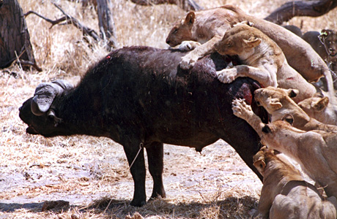
What are some ways selection can occur?
Predators- Predators will usually kill those prey that are too weak, sick or standout. Thinning or removing undesirable traits (genes) from the population while strengthening desirable traits in the population.
http://www.youtube.com/watch?v=6xh2YpA1JzE

Slide 9
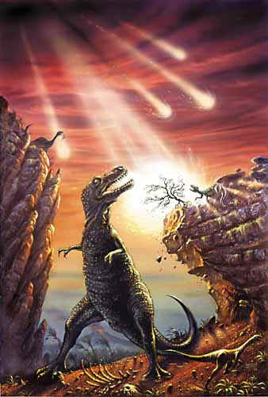
What are some ways selection can occur? (cont)
Climate change- Individuals that do well in one climate may not do well in another. If there is a sudden change in climate, only those that have adaptable traits, will survive.
http://www.youtube.com/watch?v=9GDKrqX4kIA

Slide 10
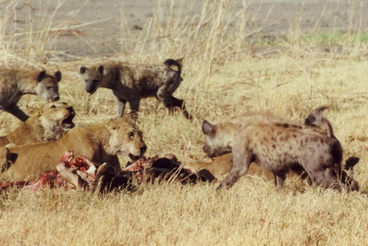
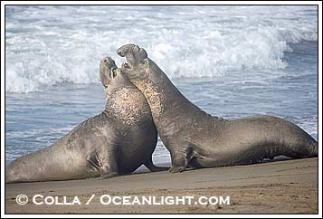
What are some ways selection can occur? (cont)
Competition- When two or more population are competing for a resource, only those that are better adapted will prevail; while the others will either find other resources or die out.
http://www.youtube.com/watch?v=fQI5KUfM2xc
http://www.youtube.com/watch?v=zJH7qtWr9ZA

Slide 11
“Survival of the Fittest”: Natural selection leads to evolution
There is genetic variation in a population giving some individuals an advantage over the others.
Those individual that survive to reproduce will produce more offspring are produced than will survive
The environment will cause organisms to compete (for food/resources, to avoid predators, or for a mate).
Individuals that are better adapted to the environment (most fit) will survive and reproduce
Those better adapted organisms pass on their traits to their offspring! Traits of those individuals that die before they reproduce will lose. (Extinct)

Slide 12
http://video.google.com/videosearch?q=survival+of+the+fittest&www_google_domain=www.google.com&hl=en&emb=0&aq=0&oq=survial+#q=survival+of+the+fittest+raptor&hl=en&emb=0
http://videos.howstuffworks.com/hsw/8273-islands-and-evolution-natural-selection-video.htm

