Slide 1
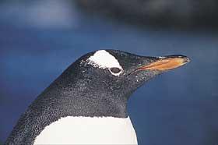
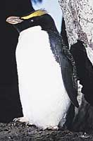
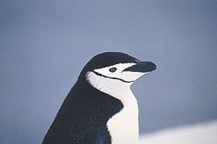
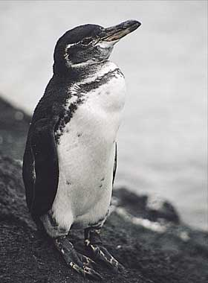
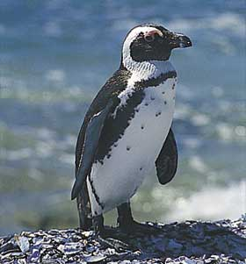
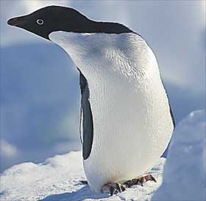
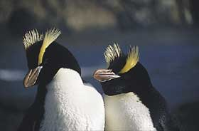
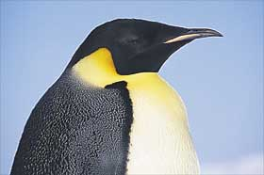
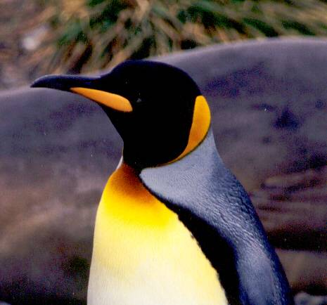
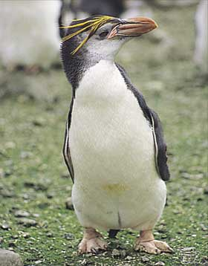
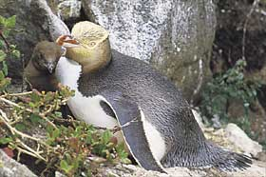
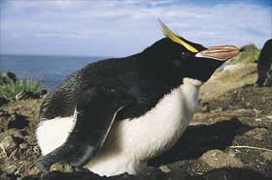
AIM: What is Evolution and who discovered it?
DO NOW: What are these birds and how would you categorize them?

Slide 2
Yellow face Feathers
Yellow Crest Feathers
Black and White Feathers Face
Non - Black and White Feathers Face
Even though they are penguins, you know that they are different species because they have tracts that are different from each other.
These are all penguins. You know this because they all have characteristics that only penguins would have.

Slide 3
What is Evolution?
Evolution is a scientific idea that tries to explain how all living things came to be.
Evolution’s principles are based on observations and comparisons of living things and their environment, fossils and similar physical and biochemical (proteins & DNA) similarities; then asking: why are there differences and similarities between organisms.
Through these observations it had been concluded that all organisms existing today came from an ancestral organism that does not exist anymore.

Slide 4
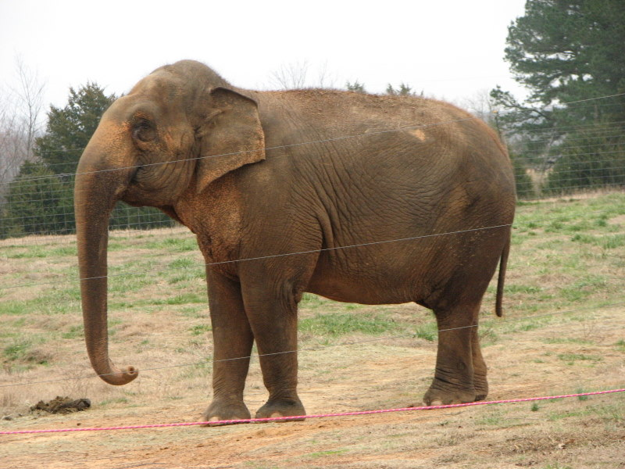
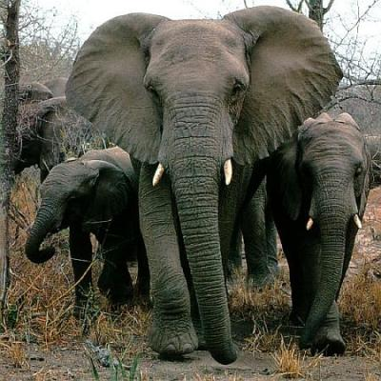
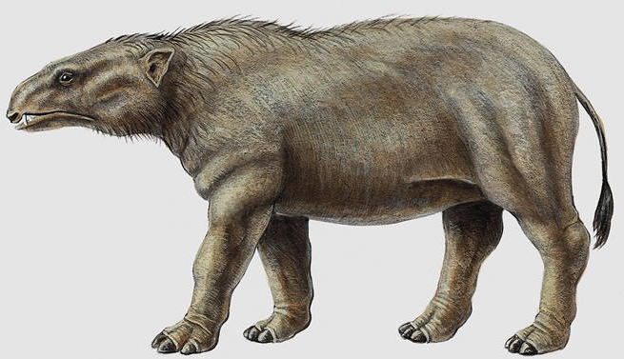
Ear size
Moeritherium
Is the ancestor of
elephants. It has
many similarities
of the modern
day elephant.
These are both elephants. What is one characteristic that makes them different from each other?

Slide 5
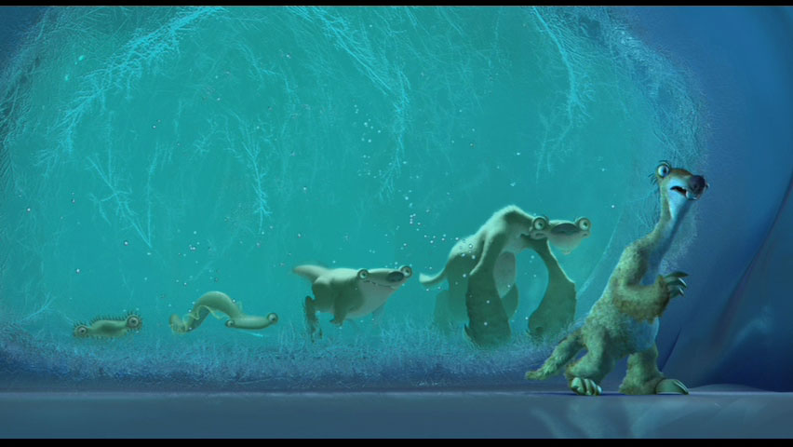
Evolution states that all the different types of species that exist today, started out as 1 specie and over time (millions of years) evolved into many different types of species.

Slide 6
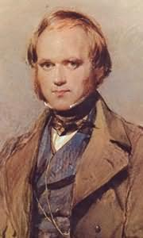
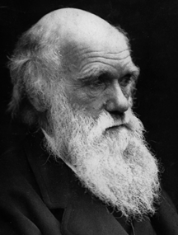
Charles Darwin 1809-1882 The Father of Evolution
Darwin’s Brief Biography
Darwin was a naturalist. When he was 22 years old, he boarded a ship named the H.M.S BEAGLE for a 5-year journey.
On the Beagle trip he made observations along many coastlines including the GALAPAGOS ISLANDS
These observations led to his explanation of how species change over time...EVOLUTION THROUGH NATURAL SELECTION

Slide 7
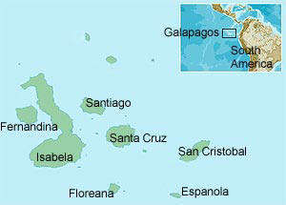
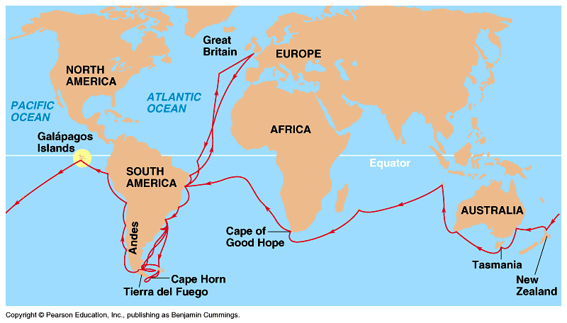
The Voyage of the H.M.S. Beagle
England
Brooklyn, NY

Slide 8
****The Galapogos Islands are important because, the islands are separated by hundreds of miles from the continent of South America, and the islands were also separated from each other. They were isolated. ****This GEOGRAPHIC ISOLATION made the islands a perfect place to observe species unique to each island (and to the world). ****This meant that all the islands may have had the same type of organisms living on them, but because of each island’s unique environment ,each organism looked and acted differently than the same type of organism that lived on another island.
Why were the Galapagos Islands important to study evolution?

Slide 9
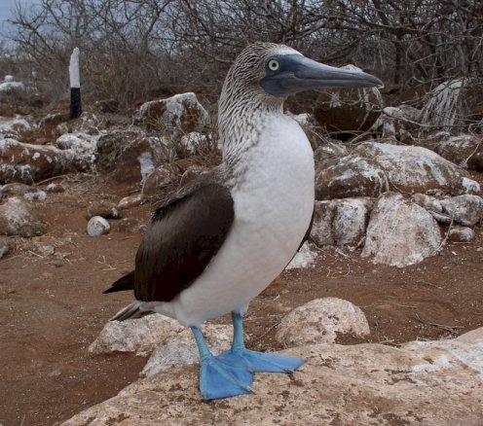
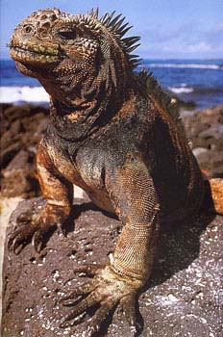
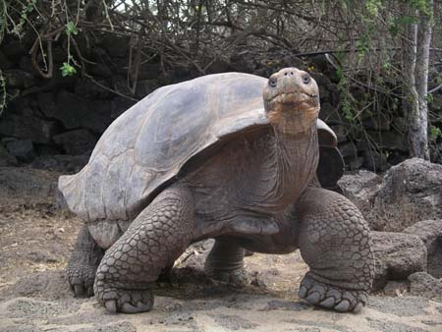
Some Unique Species of the Galapagos Islands
Galapagos
Boobies
Galapagos
Tortoises
Galapagos
Marine
Iguanas

Slide 10
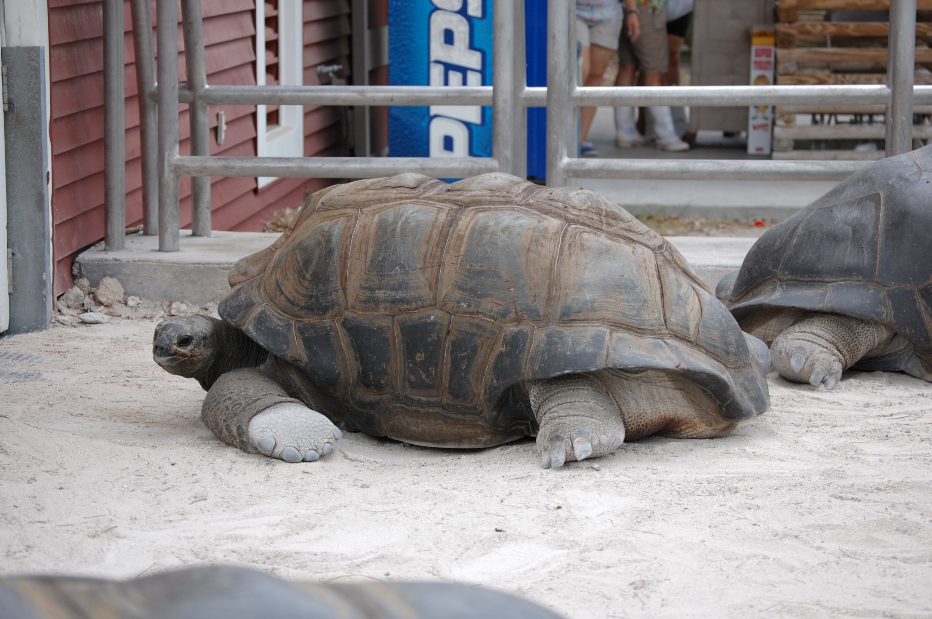
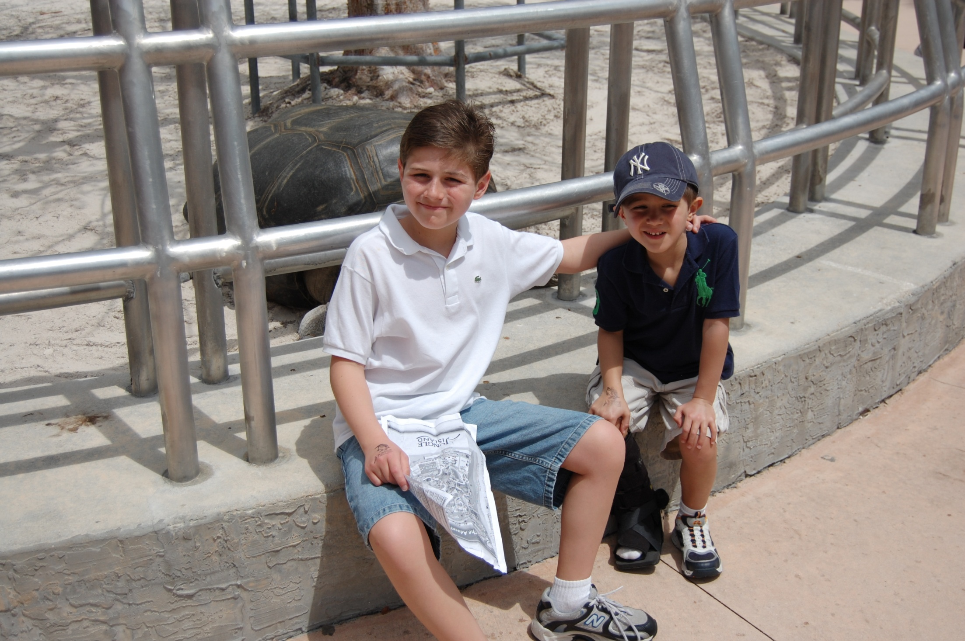
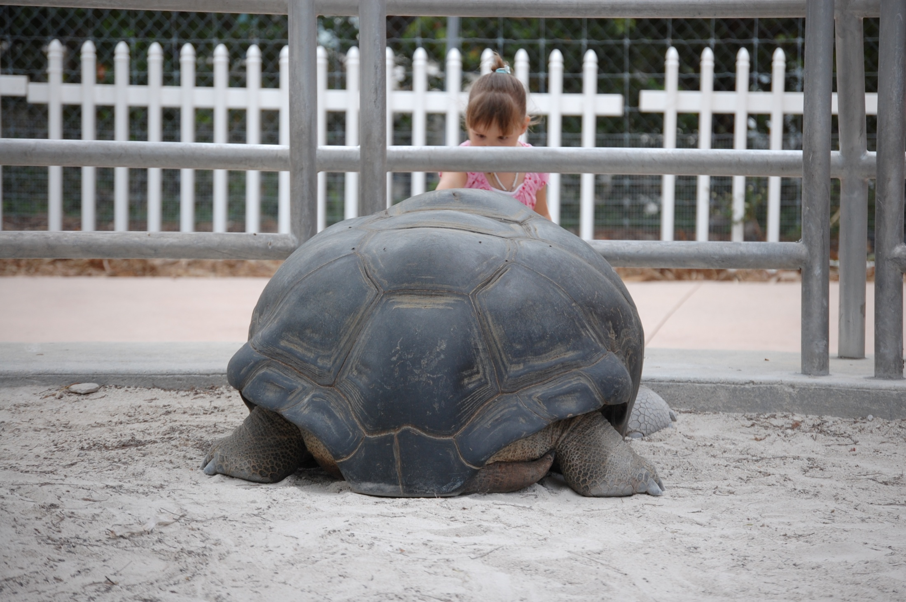
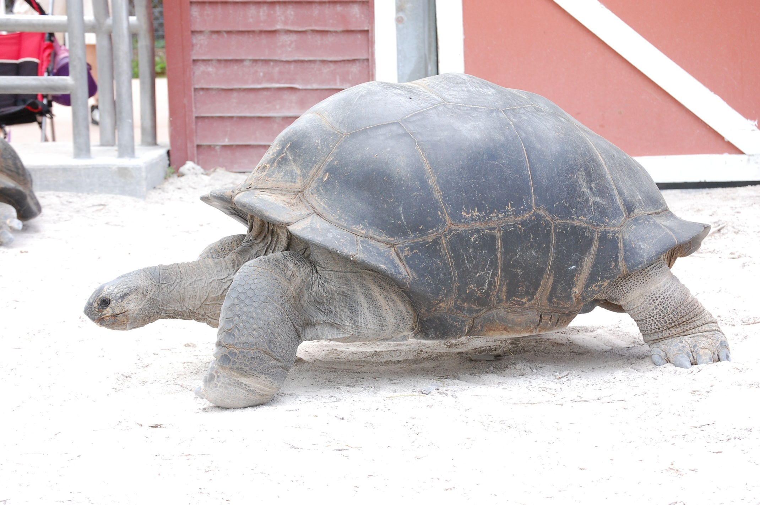
Over 180 years old

Slide 11
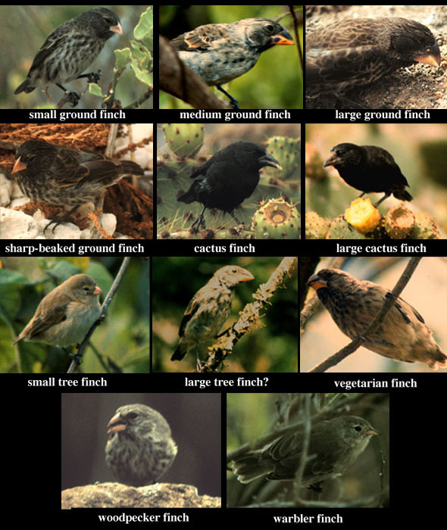
*Darwin was interested in the many different types of finches found on each of the Galapagos Islands. *He observed that each Island had it’s own type of finch. *The evolution of each different type of finch was due to the finch's diet on that particular island. Those finches that were better adapt to eat the food on that island lived, while those that could not adapt would die out.

Slide 12
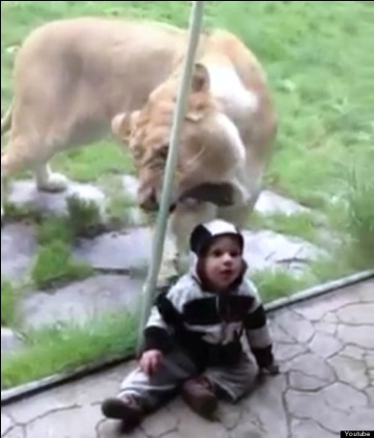
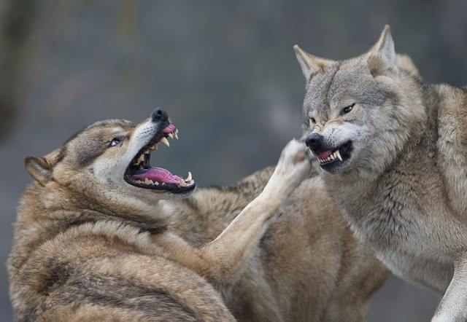
What did Darwin learn from his observations?
Darwin made 5 discoveries through his observations.
1) Genetic Variation- many organisms in a group have similar traits but at the same time they are different from each other. (mutations)
2) Overproduction of Offspring – organisms produce a lot of offspring because they know that some of the offspring will die before reproductive age.
3) Competition – organisms may compete for resources (food, water, shelter, mates) causing some to eliminate their competitors or fill specific niches (jobs).

Slide 13
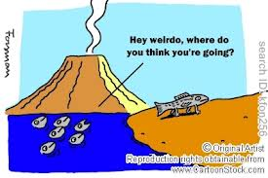
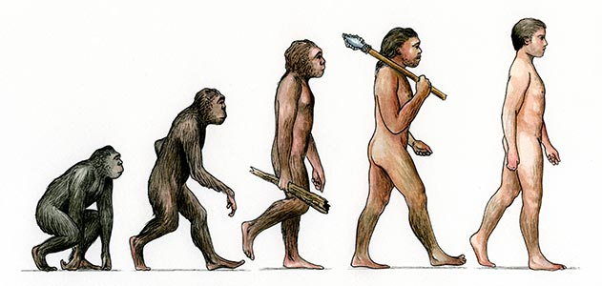
What did Darwin get from his observations?
4) Natural Selection – those organisms that have the desirable traits (fittest) will survive and be able to reproduce. Those that do not have these desirable traits will become extinct.
5) Change in Traits – due to mutations and changes in the environment, many new genes develop. If the mutation helps the organism survive, the mutation may be passed to new offsprings. But if a mutation hinders chances of survival, the new gene will not be passed on because the organism will die before it can reproduce. (done over a long period of time)

Slide 14
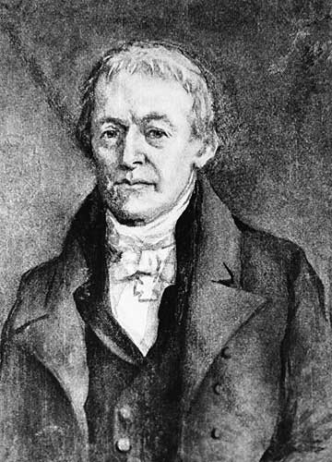
Jean-Baptiste Lamarck
50 years before Darwin another scientist had his own idea of how evolution occurred.
He was the first to attempt to explain scientifically how species evolve and change over time.

Slide 15
Lamarck’s Theory
Lamarck believed that when environments changed, organisms had to change their behavior and anatomy to survive.
If an organism began to use a body part more than they had in the past, that body part would increase in size during the lifetime of that organism. This is called acquired traits.
Lamarck believed if a giraffe stretched its neck to reach for high leaves, its neck would get longer. Its offspring would inherit the longer neck, and continued stretching would make it longer still over several generations.
Meanwhile organs that organisms stopped using would shrink and eventually vanish.

Slide 16
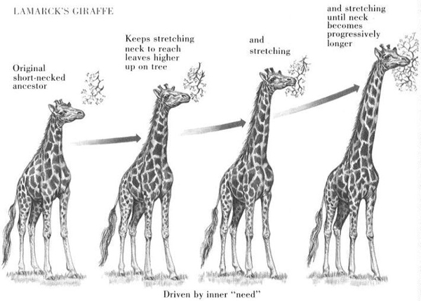

Slide 17
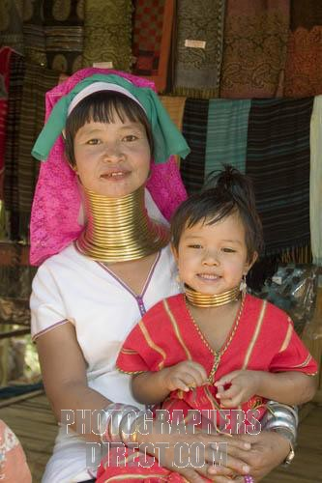
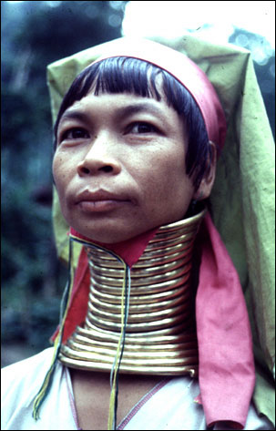
Unfortunately for Lamarck theory, acquired characteristics are NOT passed on to offspring.
Because these characteristics do not affect your DNA/genes, they cannot be inherited.
A tattooed woman will not give birth to a tattooed baby.

Slide 18
Let’s Compare!
Darwin Lamarck
Variations within species
Inheritance of parents genes
Only those that are fittest will pass their traits
Species who fail to pass on their traits will become extinct
Traits are shown when they are used
Parents can pass on these “acquired” traits to their offspring.
There was an increasing complexity with in all organisms
There was no such thing as extinction.

