Slide 1
Do Now: Write down 3 things that you are looking for in a potential mate?
Aim: How does an organism’s behavior aid in the evolution of a species?

Slide 2
How does an organism increase its chances to be successful?
Many organisms develop complex behaviors in order to be successful.
Some behaviors help them to survive while other behaviors help the organism attract mates.
These behaviors include feeding pattern, migrations and mating rituals.

Slide 3
Why is Pattern Behavior so Important for Evolution?
Pattern behavior is behavior that a group of organisms do in order to increase their chances for survival as a group.
Because individual organisms in the group have these patterns behavior, unfavorable or undesirable traits are selected out of the population. This is because these individual with the ideal behavior would reproduce and pass on their genes.
These patterns also strengthen favorable or desirable characteristics because only the fittest or best adapted will live and reproduce; thereby passing on their genes.

Slide 4
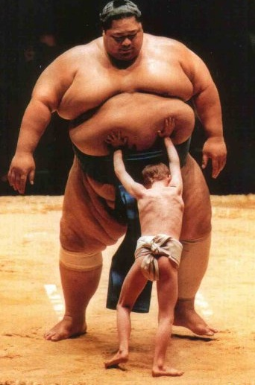
How is success measured in living things?
Nature measures success by how well an organism can reproduce.
Those organisms that can reproduce will be able to pass on their genes to the next generation allowing the species to continue on.
Those organisms that do not reproduce are considered failure because they do not pass on their genes.
If enough failures occur, the specie will become extinct.

Slide 5
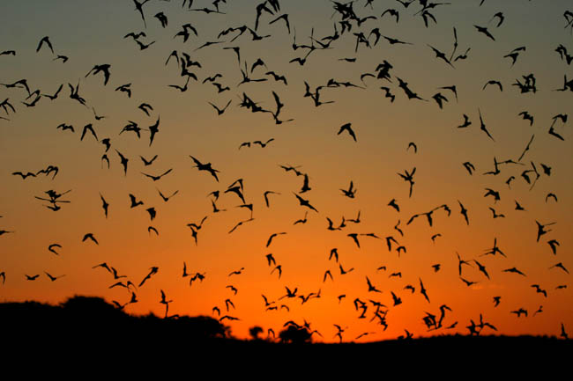
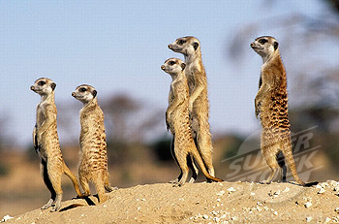
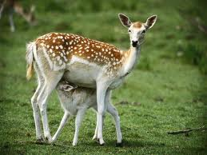
Feeding Pattern Behavior
Feeding patterns behavior can develop from many things:
Organisms know when their food is more abundant. (nighttime, morning, at a certain place or during a certain time of the year).
Organisms know when predator that eat them are out so they avoid those times and places.
Most organisms give birth during certain times of the year and certain places where food is abundant.
If the food source changes or dies out, only those populations with the most variety will survive.

Slide 6
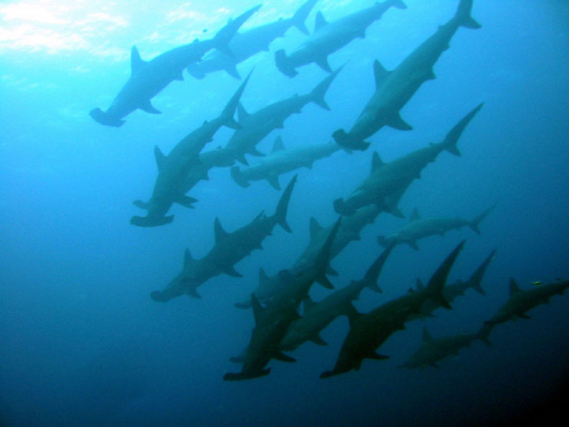
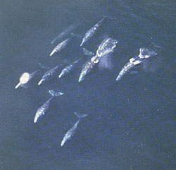
Migration Patterns
Migration means that a group of the same type of organisms move from one area to another. Organisms do this for many reasons:
Follow their food source
To reproduce
To find mates
To have offspring
To raise offspring
Only those that are the fittest to make the trip will survive.

Slide 7
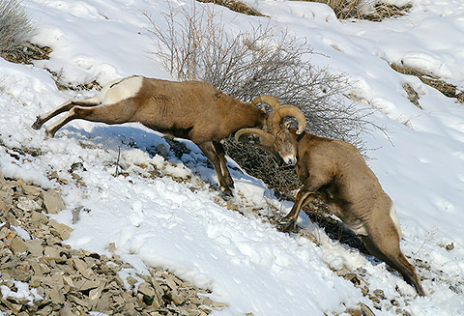
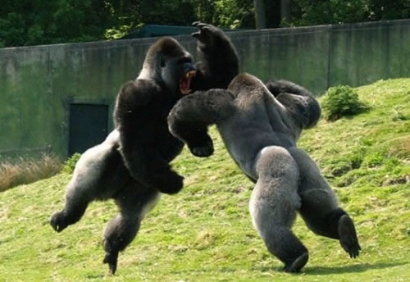
Mating patterns
Many organisms have very complex mating rituals.
These rituals are designed to allow only the most fittest individuals to survive or reproduce.
Some rituals include: shelter building, special dancing or movements, display of particular traits and combat.

Slide 8
Is Pattern Behavior Learned or Genetic?
Some scientist believe that this type of behavior is learned by watching others in the population.
Animals that were born in zoos and were isolated from other of its kind, have a hard time adapting to the wild because they do not known how to act.
Some scientist believe that Pattern Behavior is instinctive (in their genes). Turtles hatching from eggs on beaches will quickly go to the water. Salmon return to the same stream that they were born to lay their eggs.

Slide 9
http://www.youtube.com/watch?v=kmvaLtNHyp0&feature=fvwrel
http://www.youtube.com/watch?v=oyt0CIIL_Mg
http://www.youtube.com/watch?v=L54bxmZy_NE
http://www.youtube.com/watch?v=bzfqPQm-ThU

