Slide 1
Aim: How does the Body Communicate?
Do now: Describe how would you pass on a short message (Like to arrange a meeting time) to a friend across the city and how would you pass on a longer message (like a paper you’d like them to read for you) to that same friend.

Slide 2
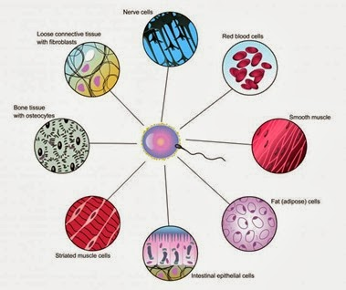
What is your body made out of?
Remember that our bodies are made out of a community of cells. Each type with their own job that helps maintain homeostasis.

Slide 3
Discussion (Write and be prepared to share)
What are some of the reasons that cells might communicate with each other?
How do you think cells communicate with one another? (For example, how do the cells in your brain communicate with the cells in your stomach?)
Describe what might happen if communication between certain cells failed.

Slide 4
What body systems does the body use to communicate?
The human body has 2 ways it sends messages:
The Nervous System is used to send short term messages using electrical impulses and neurotransmitters.
The Endocrine System is used to send long term messages using glands and hormones.

Slide 5
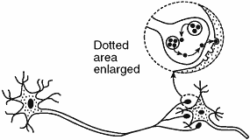
What are nerve signals?
Our body’s nervous system is made up of billions of nerve cells. These connect to form the tissues and organs of the nervous system.
Electricity passes throughout the cell which causes the release of a protein called neurotransmitter which travels from the nerve to another cell.

Slide 6
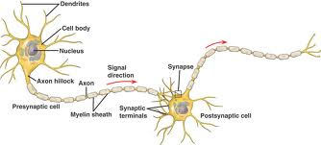
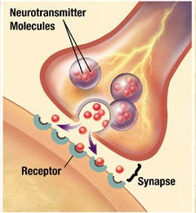
What are synapses?
Synapses are spaces between 2 neurons or neurons and body cells. Neurotransmiters move from one cell to another to activate a function of that cell.

Slide 7
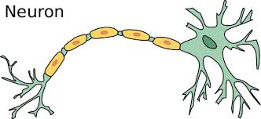
Nucleus

Slide 8
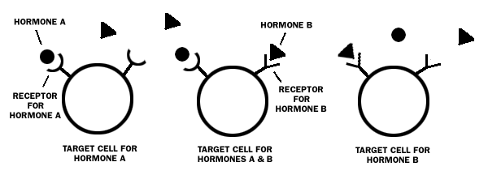
What are hormones?
Hormones are protein chemical messengers that travel throughout the body coordinating complex processes like growth, metabolism, and fertility.

Slide 9
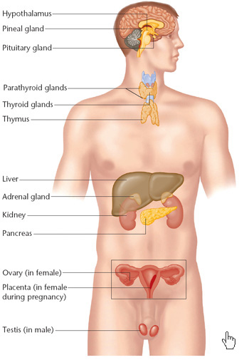
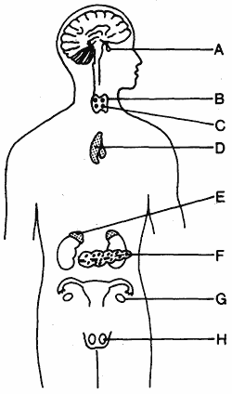
Where are hormones made?
They are produced by organs called glands. These include the two adrenal glands, the pituitary gland, the four parathyroid glands, the sex glands (ovaries and testis), the pancreas, the thyroid gland and the thymus gland.
Pituitary
Thyroid
Parathyroid
Thymus
Adrenal
Pancreas
Ovaries
Testis

Slide 10
How do hormones work?
Different and specific hormones affect different and specific cells and cause specific actions to happen.
Example:
The pancreas secretes (releases) insulin which “tells” cells that there is too much glucose in the blood and they have to take it in.
The pancreas also secretes glucagon which tells the cells in the liver that there is too little sugar in the blood and that they have to convert stored fat into glucose

Slide 11
What is the difference between hormonal and nerve signaling?
Hormonal signaling sends slow, graded messages throughout the body that are read by cells with specific receptors.
Nerve signaling sends rapid, digitized messages over fixed connections.
Neural communication is more voluntary than hormonal communication.

Slide 12
Exit slip
What is the name of the cells that makes up the nervous system?
What is the name of the type of organs that make hormones?
What type or organic molecules are neurotransmitters and hormones? (they are the same)
What are 2 differences between the signals of the nervous system and the endocrine system?

