Slide 1
Aim: What is the musculoskeletal system?
Do now: The Achilles tendon is the tendon that connects the calf muscle to the heel of the foot. If that tendons is cut, what movement will the foot not be able to do?
Notes:
1 Engage: This phase of the 5 E's starts the process. An "engage" activity should do the following:
Make connections between past and present learning experiences
Anticipate activities and focus students' thinking on the learning outcomes of current activities. Students should become mentally engaged in the concept, process, or skill to be learned.

Slide 2
What makes up the Musculoskeletal system?
Both the muscular system and skeletal system work so closely together that they are sometimes called the musculoskeletal system.
The organs that make up these systems include:
Bones-provides a strong rigid frame for the body
Tendons – attaches bones to muscles
Ligaments – attaches bones to other bones
Muscle - specialized tissue that contracts and allow us to move
Cartilage-cushion between bones
Notes:
2 Explore: This phase of the 5 E's provides students with a common base of experiences. They identify and develop concepts, processes, and skills. During this phase, students actively explore their environment or manipulate materials.

Slide 3
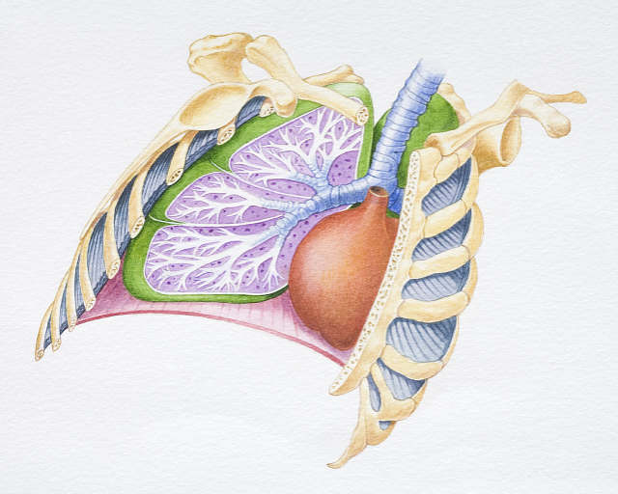
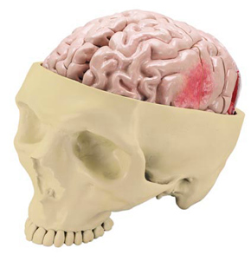
What are the functions of the Musculoskeletal system?
Protects major organs such as the brain, heart and lungs
Makes blood
Allow us to move voluntarily (willingly and knowingly)
Notes:
3 Explain: This phase of the 5 E's helps students explain the concepts they have been exploring. They have opportunities to verbalize their conceptual understanding or to demonstrate new skills or behaviors. This phase also provides opportunities for teachers to introduce formal terms, definitions, and explanations for concepts, processes, skills, or behaviors.

Slide 4
How can we move voluntarily?
Muscles come in pairs and attach to the skeleton .
What attaches muscles to bones?
Tendons
One muscle to move the bone in one direction and another to move it back the other way.

Slide 5
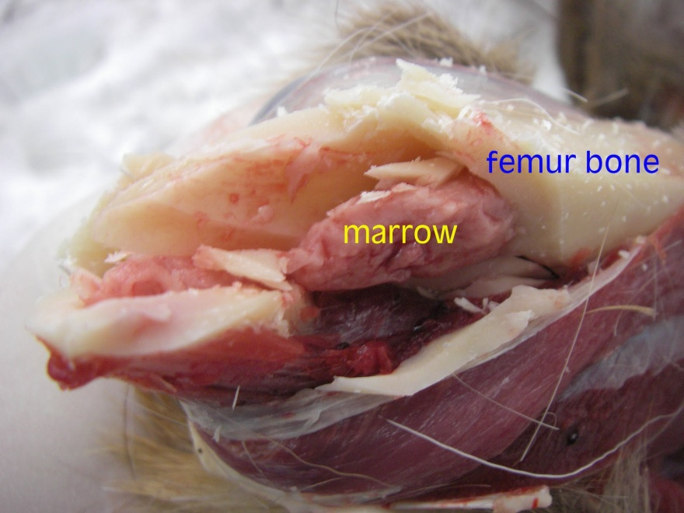
What is the bone marrow?
Bone marrow is the spongy tissue inside some of your bones, such as your hip and thigh bones. It has cells called stem cells. These stem cells can develop into the red blood cells, the white blood cells and platelets
Notes:
4 Elaborate: This phase of the 5 E's extends students' conceptual understanding and allows them to practice skills and behaviors. Through new experiences, the learners develop deeper and broader understanding of major concepts, obtain more information about areas of interest, and refine their skills.

Slide 6
How do muscles help maintain Homeostasis?
What does your body do when you are cold?
When we shiver, that is our bodies trying to get us warm.
Muscles have a lot of mitochondria and produce a lot of energy. Some of this energy is heat.
Notes:
5 Evaluate: This phase of the 5 E's encourages learners to assess their understanding and abilities and lets teachers evaluate students' understanding of key concepts and skill development.

Slide 7
Lets see if we got this.
3 Functions of the musculoskeletal system?
Where is blood made?
What is the function of tendons?
What the function of ligaments?
How do muscles help maintain homeostasis?

