Slide 1
Aim: What is the function of the urinary system?
Do now: Why is feces not considered cellular waste?
Notes:
1 Engage: This phase of the 5 E's starts the process. An "engage" activity should do the following:
Make connections between past and present learning experiences
Anticipate activities and focus students' thinking on the learning outcomes of current activities. Students should become mentally engaged in the concept, process, or skill to be learned.

Slide 2
What is the difference between urine and feces?
Feces is what is left over from when we eat.
Urine is the way our bodies get rid of Metabolic waste.
Metabolic waste is waste made by all the cells in our body such as urea, waste made by breaking down protein.
Notes:
2 Explore: This phase of the 5 E's provides students with a common base of experiences. They identify and develop concepts, processes, and skills. During this phase, students actively explore their environment or manipulate materials.

Slide 3
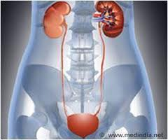
What is urinary system?
The system that includes all organs involved in making and excreting (eliminating) of urine.
It includes:
Kidneys: bean-shaped organs about the size of your fists near the middle of the back
Ureters: two thin tubes that move urine to the bladder
Bladder: hollow organ shaped like a balloon
Urethra: tube that allows urine to pass outside the body
Notes:
1 Engage: This phase of the 5 E's starts the process. An "engage" activity should do the following:
Make connections between past and present learning experiences
Anticipate activities and focus students' thinking on the learning outcomes of current activities. Students should become mentally engaged in the concept, process, or skill to be learned.

Slide 4
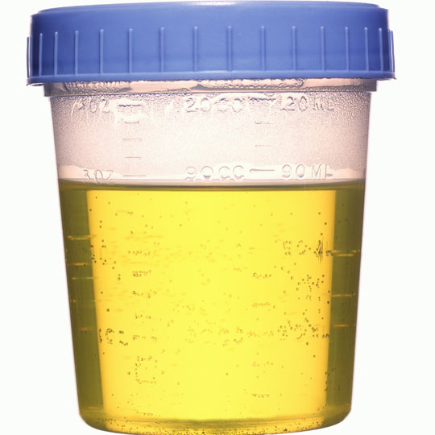
How is urine made?
The waste made by the cells is diffused back into the blood.
The blood carries the waste to the kidneys
Like the lungs, the kidneys have a lot of blood vessels going through it.
Capillaries surround small structures is the kidneys called nephrons. These collect the waste and collected mix it with water
The resulting mix is urine.
Notes:
3 Explain: This phase of the 5 E's helps students explain the concepts they have been exploring. They have opportunities to verbalize their conceptual understanding or to demonstrate new skills or behaviors. This phase also provides opportunities for teachers to introduce formal terms, definitions, and explanations for concepts, processes, skills, or behaviors.

Slide 5
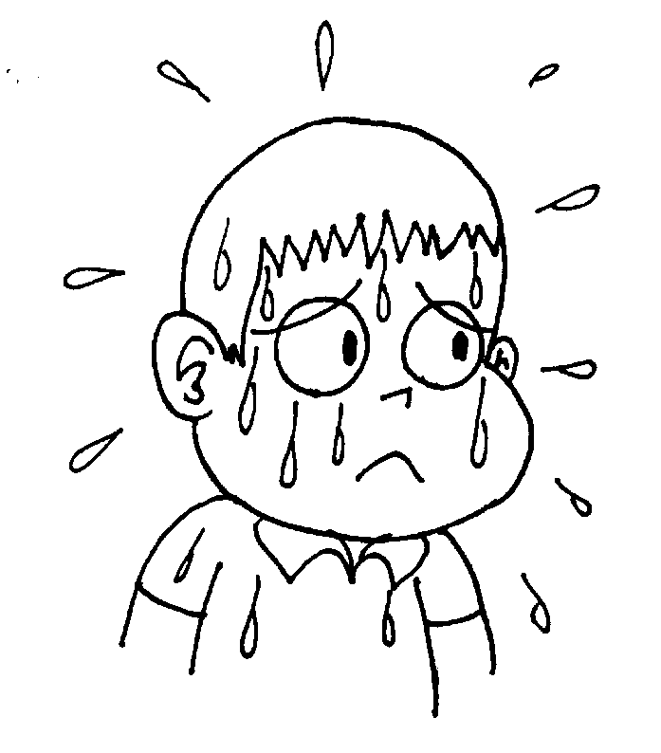
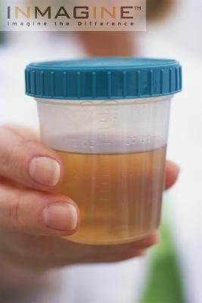
Adjustment of the water content
Water is taken into the body as food and drink and is lost in three ways
Urine
Sweat
Breath

Slide 6
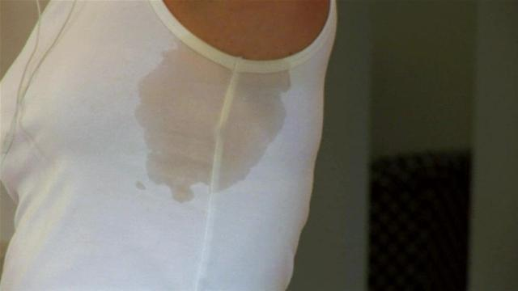
Do we sweat pee?
The same waste that excreted in urine is the same that is excreted in sweat. This is the reason both sweat and urine are salty. And the reason your white shirts sometimes get yellow under arms.
Notes:
4 Elaborate: This phase of the 5 E's extends students' conceptual understanding and allows them to practice skills and behaviors. Through new experiences, the learners develop deeper and broader understanding of major concepts, obtain more information about areas of interest, and refine their skills.

Slide 7
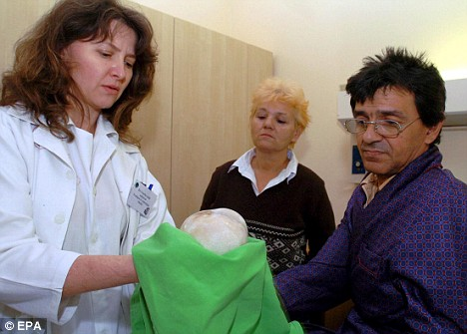
Do Not Copy
Sometimes the concentration of urine is so great that minerals in the urine bind together forming small stones.
If the stones are small enough, they can pass through the urinary tract.
If the stones are large, they made need to be surgically removed.
The largest kidney stone was 2.5 lb and the size of a coconut.

Slide 8
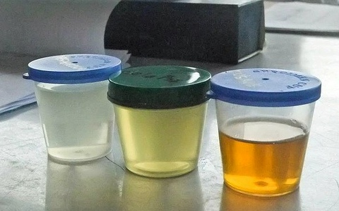
Do you pee more in the summer or winter?
On cold days you pee more. This is because you sweat less. This urine is light in color and less concentrated
On Hot days you pee less. This is because you sweat more using up more water. This urine and darker in color more concentrated.

Slide 9
Lets make sure we got this
What is urine?
What 4 organs make up the urinary system?
When would you pee more, winter or summer?
Why?
Notes:
5 Evaluate: This phase of the 5 E's encourages learners to assess their understanding and abilities and lets teachers evaluate students' understanding of key concepts and skill development.

